Slide 1
COLLEGE FINDER

Slide 2
ABSTRACT
The project college selector system is an application where students can search and enroll for different colleges that they want. Student can search for the colleges through their system at anytime and anywhere. This system is developed for students looking out for admission in best colleges. Also it will help colleges to get more students being enrolled into the institute. The system will provide a list of colleges to students from which they can select their required college. After selecting the college, student has to give a test in order to enroll themselves for the admission. Students have to give the test and the results are displayed on the spot by the system to the student. The system also sends the result to respective colleges for evaluation purposes along with student’s details. Hence the initial procedure of conducting an admission can be automated through this system.

Slide 3
INTRODUCTION
A college finder system main objective of that students can finding the their suitable college via this project, the student who are finishing the school they will their college based on marks, its very useful for the students. Admin login and added college details and which could be automatically search and give result to the students. Everyone can using this software, it will be more comfortable to use it.. The project is aimed to develop by JAVA as Front end and MS SQL SERVER as Back end. The back end is used to store the information in this system.

Slide 4
HARDWARE SPECFICATION
Processor : P 4 700 GHz.
RAM : 4 GB RAM
Hard Disk Drive : 180 GB

Slide 5
SOFTWARE SPECIFICATION
Operating System : Windows 7/8/10
Front End : JAVA
Back End : SQL

Slide 6
SYSTEM STUDY - EXISTING SYSTEM
The Existing system of college finder the student has to search the whole college in web site but it will not give proper details about the college also it could not shown the specific college based on the student 12 th mark. This system is very hard to find the college details. Which is not possible to view the college details in same place. So the proposed system will help to avoid the drawbacks.

Slide 7
PROPOSED SYSTEM
The system automates the manual procedure of applying for admission in colleges . No need for students to go to different college for applying for admissions or enquiry. They can get a brief list of all the colleges at a single place. The system acts as a mediator between the student and college. It notifies the colleges of students enrolling for admission by emailing them so that it becomes easier for them to get students details and evaluate

Slide 8
Modules tYPES OF MODULE
1.Admin login
2.Student login
3.College list and Selection
4.College details
5.Admission

Slide 9
Admin login:
The system will be under sole control of an admin who provides inputs to the system. Admin will update or add/delete different colleges from the system.
Student login:
Any student can login into the system by creating an account. He has to provide all the required information that is needed by a college by filling out a form.
College list and Selection:
After creating a login into the system, each student can see a list of colleges along with their details. Student can select different colleges as per their preference.

Slide 10
Student Registration :
Student can register their account self way, before creating the account they should select the registration page and give their details. This screen will collect all the information about student and qualification details. once they enter the details it will store in the database.
College details:
Student can view the college details, first select the college and view that college details. based on the student marks it will list out the college details as per the record. Also which was already stored in the college details database.

Slide 11

Data Flow Diagram
Level 0

Slide 12
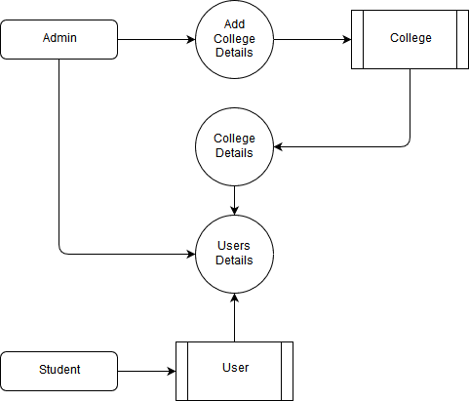
Level 1:

Slide 13
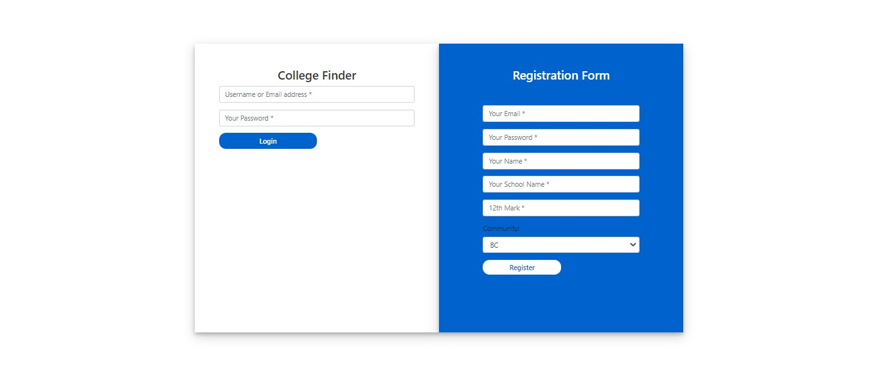

Slide 14
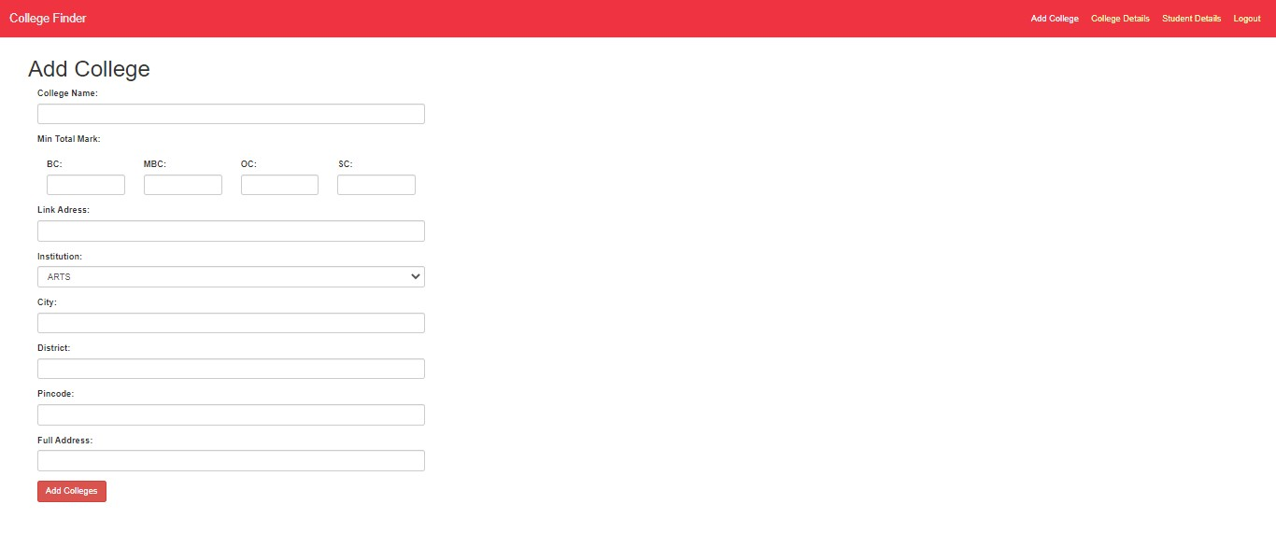

Slide 15
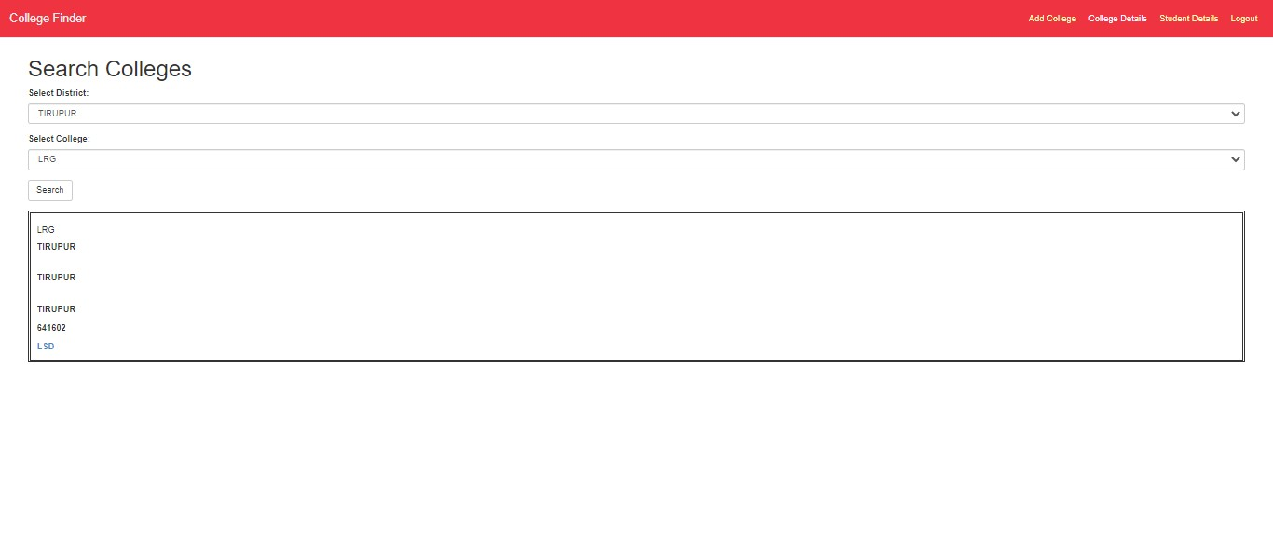

Slide 16
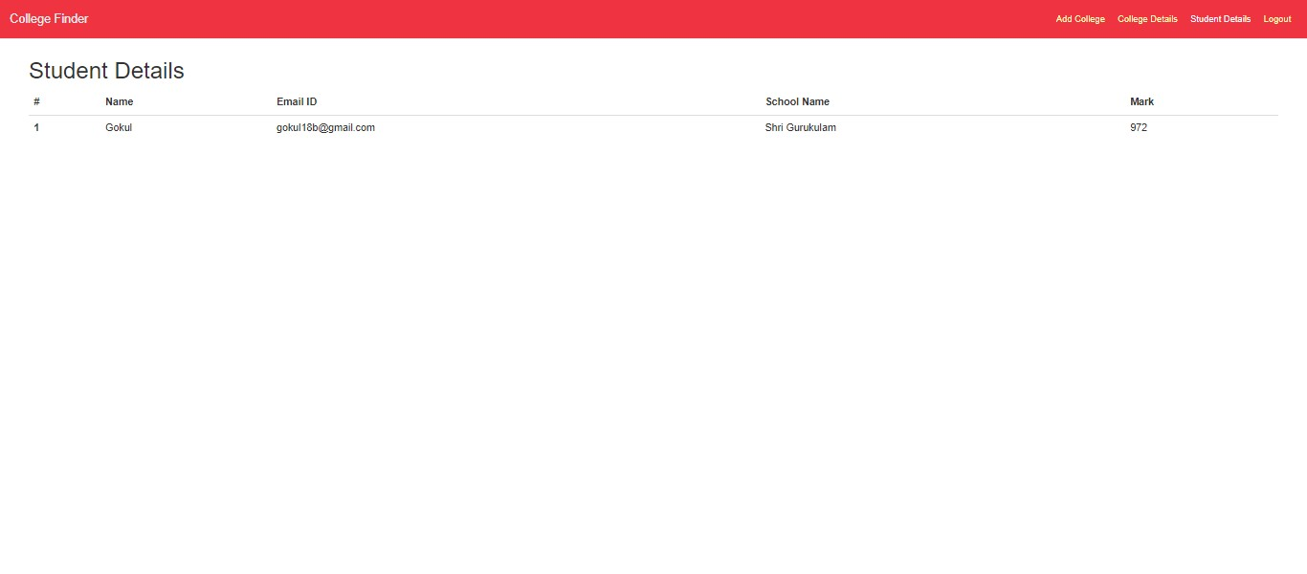

Slide 17
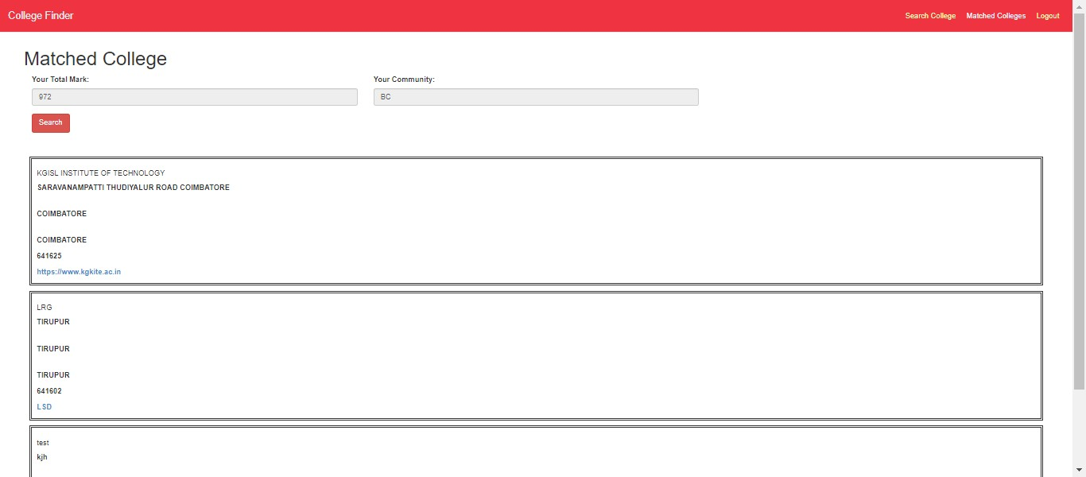

Slide 18
Thank You

